Slide 1
Forest
F I r e
PRESENTED BY
李明达
常玉林
郭宗颖
王赫男
唐昱泽
任远

Slide 2
Forest
F I r e
PRESENTED BY
李明达
常玉林
郭宗颖
王赫男
唐昱泽
任远

Slide 3
CONTENTS
1
2
3
4
PART ONE
PART TWO
PART THREE
PART FOUR
What is Forest Fire
The Harm of It
How to Prevent It
How to Deal with It

Slide 4
PART ONE
What is Forest Fire

Slide 5
PART ONE
What is Forest Fire
Definition
01
An uncontrolled fire in an area of combustible vegetation occurring in rural areas.

Slide 6
PART ONE
What is Forest Fire
01
02
Definition
An uncontrolled fire in an area of combustible vegetation occurring in rural areas.

Slide 7
PART ONE
What is Forest Fire
01
Definition
An uncontrolled fire in an area of combustible vegetation occurring in rural areas.
02
Causes
dry climate
lightning
volcanic eruption

Slide 8
PART ONE
What is Forest Fire
01
Definition
An uncontrolled fire in an area of combustible vegetation occurring in rural areas.
02
03
Causes
dry climate
lightning
volcanic eruption

Slide 9
PART ONE
What is Forest Fire
01
Definition
An uncontrolled fire in an area of combustible vegetation occurring in rural areas.
02
Causes
dry climate
lightning
volcanic eruption
Spread
03
The spread of wildfires varies based on the flammable material present, its vertical arrangement and moisture content, and weather conditions.

Slide 10
PART ONE
What is Forest Fire
01
Definition
An uncontrolled fire in an area of combustible vegetation occurring in rural areas.
02
Causes
dry climate
lightning
volcanic eruption
03
The spread of wildfires varies based on the flammable material present, its vertical arrangement and moisture content, and weather conditions.
Spread
Notes:
There are many factors of the spread of the wildfire.

Slide 11
PART TWO
The Harm of It

Slide 12
Impact on wildlife
Forest fires kill animals directly and destroy local habitats.
PART TWO
The Harm of It
01
Airborne hazards
02
The release of hazardous chemicals from the burning of wildland fuels also significantly impacts health in humans.

Slide 13
PART TWO
The Harm of It
Impact on wildlife
01
Forest fires kill animals directly and destroy local habitats.
Airborne hazards
02
The release of hazardous chemicals from the burning of wildland fuels also significantly impacts health in humans.

Slide 14
PART TWO
The Harm of It
Impact on wildlife
01
Forest fires kill animals directly and destroy local habitats.
Airborne hazards
02
The release of hazardous chemicals from the burning of wildland fuels also significantly impacts health in humans.
03
At-Risk Groups
Fire Fighters
Residents

Slide 15
PART TWO
The Harm of It
Impact on wildlife
01
Forest fires kill animals directly and destroy local habitats.
Airborne hazards
02
The release of hazardous chemicals from the burning of wildland fuels also significantly impacts health in humans.
03
At-Risk Groups
Fire Fighters
Residents

Slide 16
PART TWO
The Harm of It
Specific Harm
Trees and shrubs will be burnt down. Many animals in the forest will die in the fire.
Endangering the life safety and property of people living nearby.
Putting out forest fire will cost a lot of manpower and material resources. A terrible fire will even threaten the firefighters.
Many forests develop tourism and build many facilities. In the event of a fire，it will cause damage to these installations.
The destruction of forest ecology will cause a series of adverse effects on soil, such as land desertification and soil erosion.
Smoke and noxious particles from fire pollute the atmosphere.

Slide 17
PART THREE
How to Prevent It

Slide 18
Strengthen the publicity of fire prevention and raise the awareness of fire prevention
PART THREE
Establish a good sense of custom, consciously eliminate fire hazards
How to Prevent It
Organize fire prevention organizations along mountain villages
Formulate forest fire prevention plan and prepare for fire fighting
Reinforce fire prevention duty to ensure unblocked information

Slide 19
PART THREE
How to Prevent It
Strengthen the publicity of fire prevention and raise the awareness of fire prevention
Establish a good sense of custom, consciously eliminate fire hazards
Organize fire prevention organizations along mountain villages
Formulate forest fire prevention plan and prepare for fire fighting
Reinforce fire prevention duty to ensure unblocked information

Slide 20
PART FOUR
How to Deal with It

Slide 21
PART FOUR
How to Deal with It

Slide 22
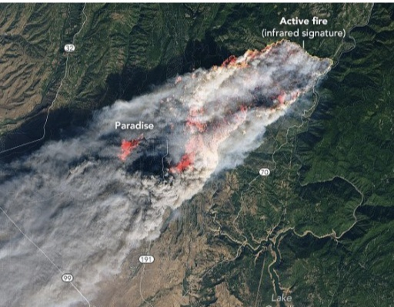
PART FOUR
How to Deal with It
remote sensing satellite
Use remote sensing satellite to judge wind direction and fire and make reasonable fire extinguishing plan.

Slide 23
PART FOUR
How to Deal with It
remote sensing satellite
Use remote sensing satellite to judge wind direction and fire and make reasonable fire extinguishing plan.

Slide 24
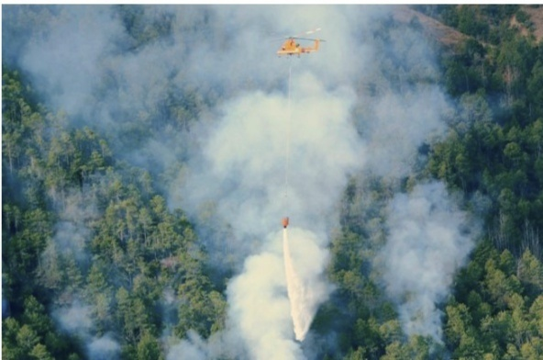
PART FOUR
How to Deal with It
water cannon
Use water cannon and helicopters to extinguish the fire.
remote sensing satellite
Use remote sensing satellite to judge wind direction and fire and make reasonable fire extinguishing plan.

Slide 25
PART FOUR
How to Deal with It
water cannon
Use water cannon and helicopters to extinguish the fire.
remote sensing satellite
Use remote sensing satellite to judge wind direction and fire and make reasonable fire extinguishing plan.

Slide 26
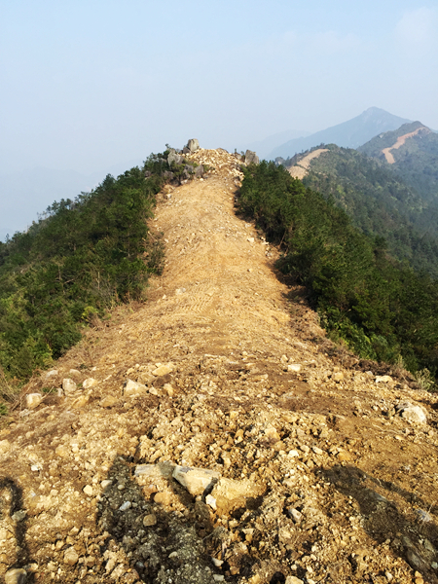
PART FOUR
How to Deal with It
water cannon
Use water cannon and helicopters to extinguish the fire.
barrier
Dig a barrier to stop the fire from spreading.
remote sensing satellite
Use remote sensing satellite to judge wind direction and fire and make reasonable fire extinguishing plan.

Slide 27
PART FOUR
How to Deal with It
water cannon
Use water cannon and helicopters to extinguish the fire.
remote sensing satellite
barrier
Use remote sensing satellite to judge wind direction and fire and make reasonable fire extinguishing plan.
Dig a barrier to stop the fire from spreading.

Slide 28
THANK YOU
FOR WATCHING

